Slide 1



Slide 2

Duty roster for NHMP
Supervised by:
Sir Armughan Ali
Group Members:
Arsalan Amjad ( SP19-MCS-001 )
Hina begum ( FA18-MCS-033 )
Naveed Hussain ( SP19-MCS-013 )
Presented on
(Cs Department) COMSATS University Islamabad
Attock Campus

Slide 3
Outline
Introduction
Problem Statement
Objectives
Methodology
Existing Apps
Functional Requirements
Tools and technology
Benefits
Work flow (diagrams)
System Screenshots
Conclusion
References

Slide 4
Introduction
We are proposing an android application name “Duty Roster for NHMP” and replacing the manual system.
Save time, remove human error & biasness.
Android as an option because its easy to use, popular and free. Moreover, officers of NHMP are well aware of using Android devices.

Slide 5
Problem Statement
Current system of making a duty roaster is manual and Admin officer of a particular beat is responsible for it.
Manual system is always time taking and effort is for manage it.
A manual system is prone to have errors in it and a level of biasness exists in it.
The problems in manual assignment of duty roster could be solved if it’s made automatic.

Slide 6
Objectives
Process of saving the manual effort by making an automated system.
Unbiased and transparent process of duty roster.
Create an alert and vigilant field formation.
Improve Professional behavior, E-ticketing, Helps.

Slide 7
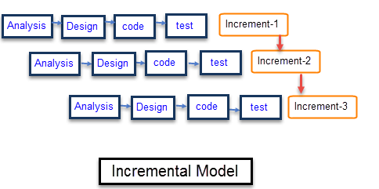
Methodology
Incremental Model
Requirements are breakdown in smaller parts
easily make those changes without changing other modules
.

Slide 8
Comparison table
Features | Plan: Roster Plan For Shifts | Plan my shift: duty roster | Roster maker | Duty Roster for NHMP
Specific for department | No | No | No | Yes
Priority/Rating based assignment | No | No | No | Yes
User interactive | Yes | Yes | Yes | Yes
View previous record | No | Yes | Yes | Yes
Automatic Duty assignment | Yes | Yes | Yes | Yes
Set preferences /choice | No | No | No | Yes
Put Up leave request | No | No | No | Yes

Slide 9
Functional Requirements
Admin
User registration/ Add officers
List users
View duty roster
View roster history
Add officer rating
Pass orders related to field
Logout
Officers
Set choices/ preferences
View roster history
Leaves
Request leave
Read orders passed by Admin officer
Logout

Slide 10
Modern tools
Tools & Technologies | Rationale
Java | Programming language
MS word | Documentation work
MS PowerPoint | Presentation work
MS Visio | Diagram work
Android Studio | Programing tool
Firebase Real Time Database | Backend work

Slide 11
Benefits
It’s a time saving process, transparent process.
Removal of human efforts.
Reward on professional behavior score and get priority, based on that score.
Users (officers) can set their preferences with just a few clicks.
Every user can check his performance hence will generate the urge to improve that.

Slide 12
Work flow
Use Case Diagram
System Use Case Diagram
Activity Diagrams
Admin Activity Diagram
Officer Activity Diagram
Class Diagram

Slide 13
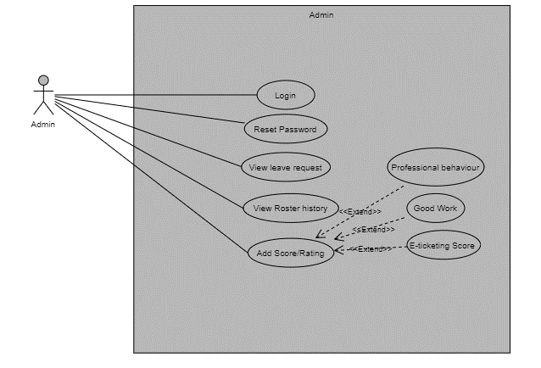
Admin Use Case Diagram

Slide 14
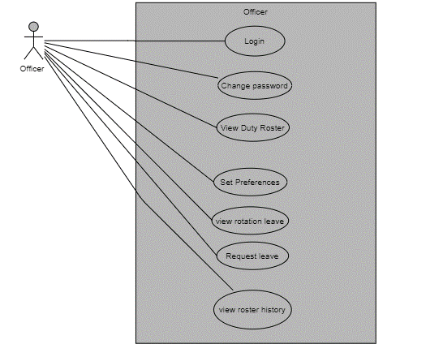
Officer use case Diagram

Slide 15
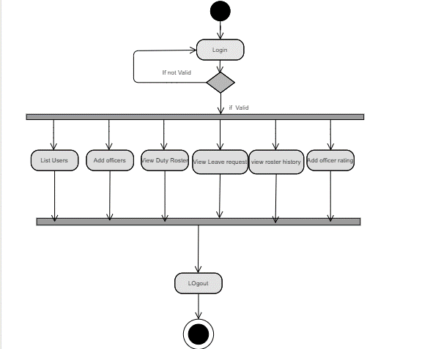
Admin Activity Diagram

Slide 16
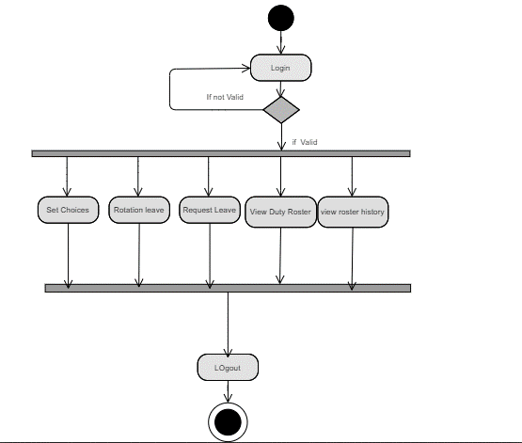
Officer Activity Diagram

Slide 17
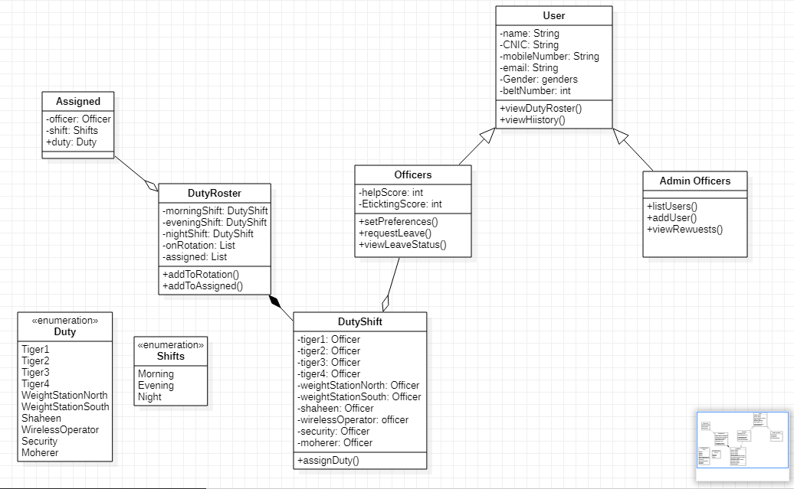
System class Diagram

Slide 18

Splash Screen

Slide 19
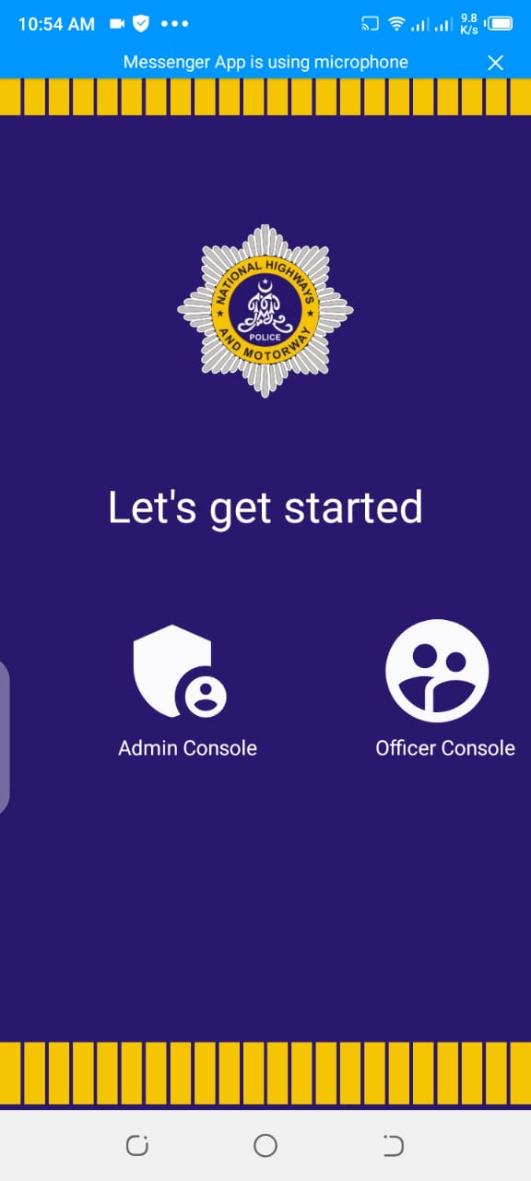
Main Activity Screen

Slide 20
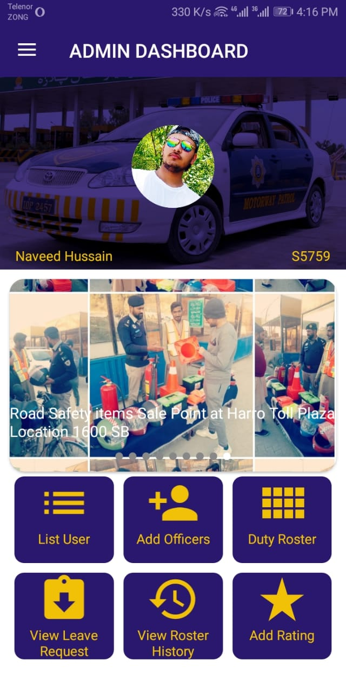
Admin Dashboard

Slide 21
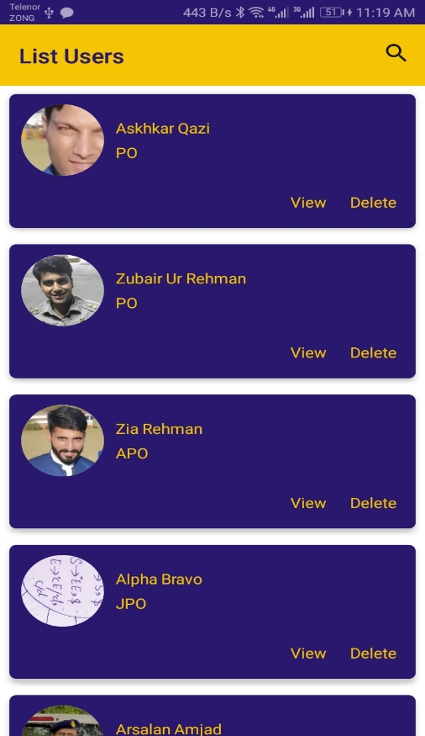
Officer list

Slide 22
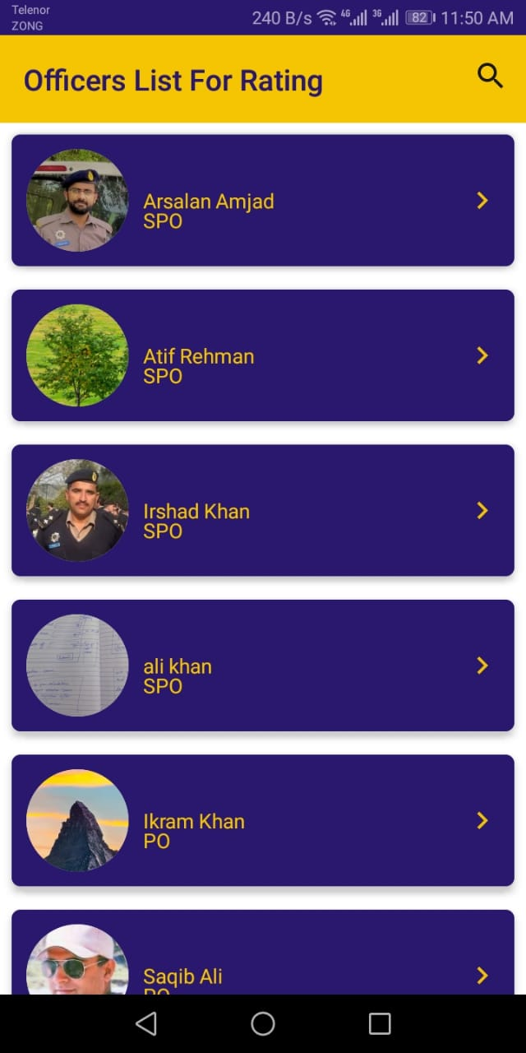
Officer list for ratings

Slide 23
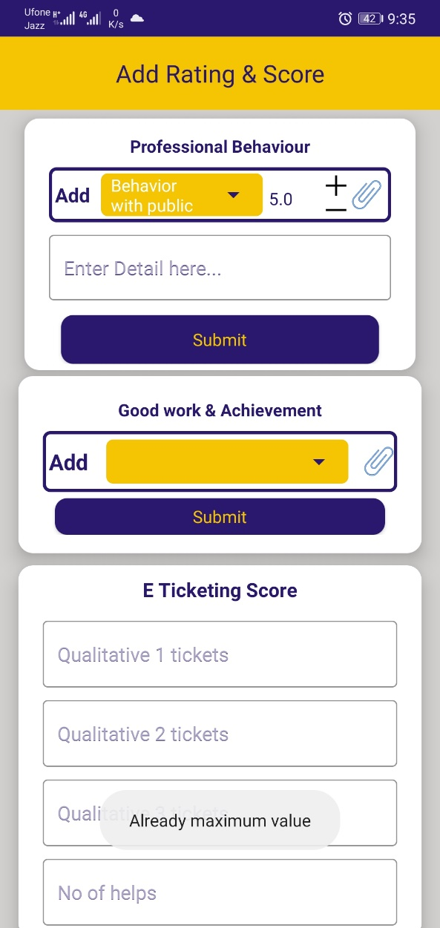
Add rating & Score

Slide 24
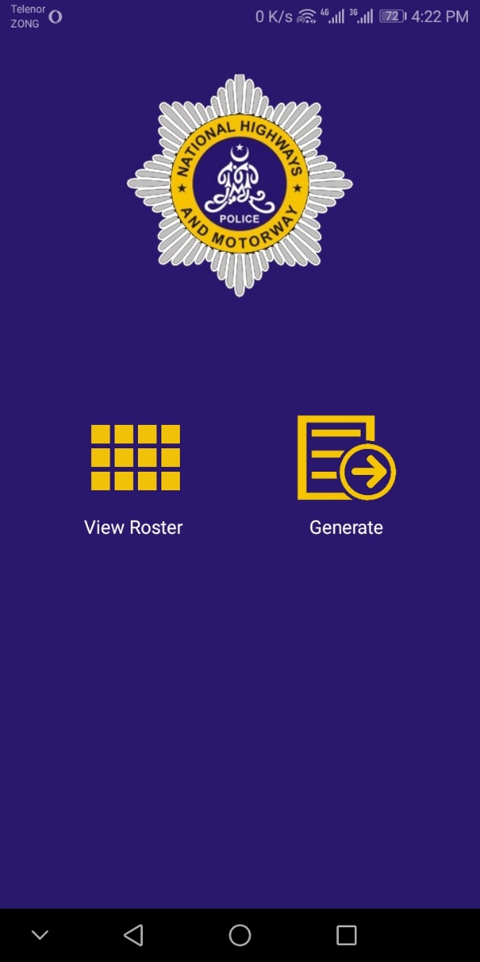
Duty Roster

Slide 25
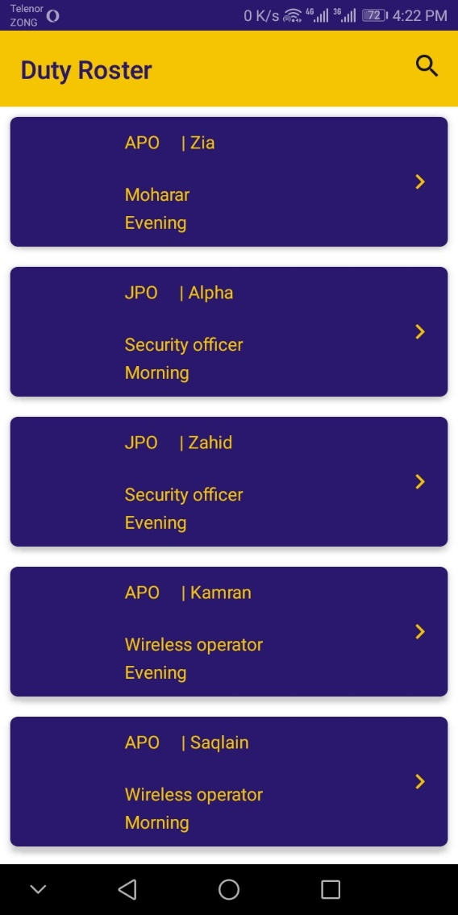
View Roster

Slide 26
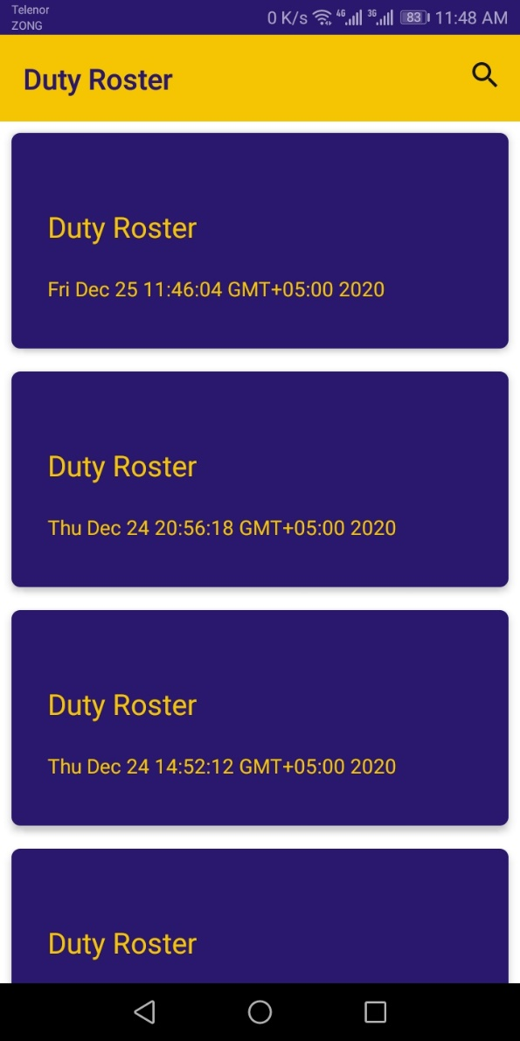
Duty roster history

Slide 27
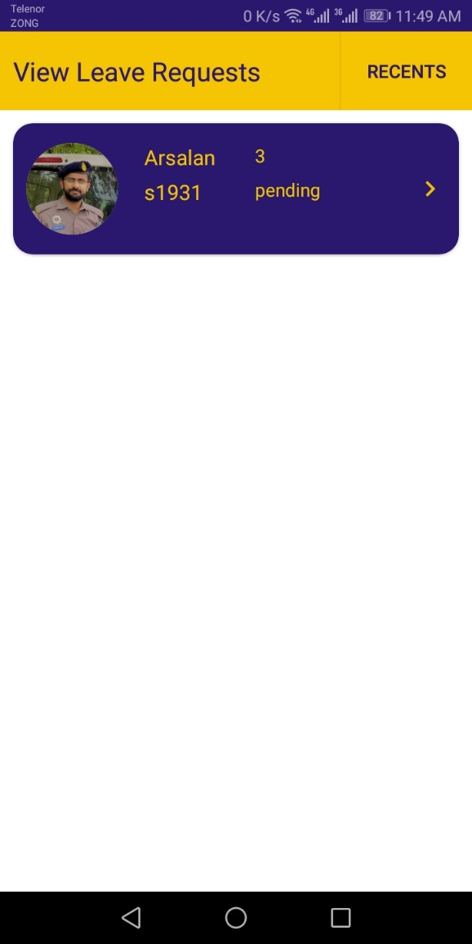
View Leave Request

Slide 28
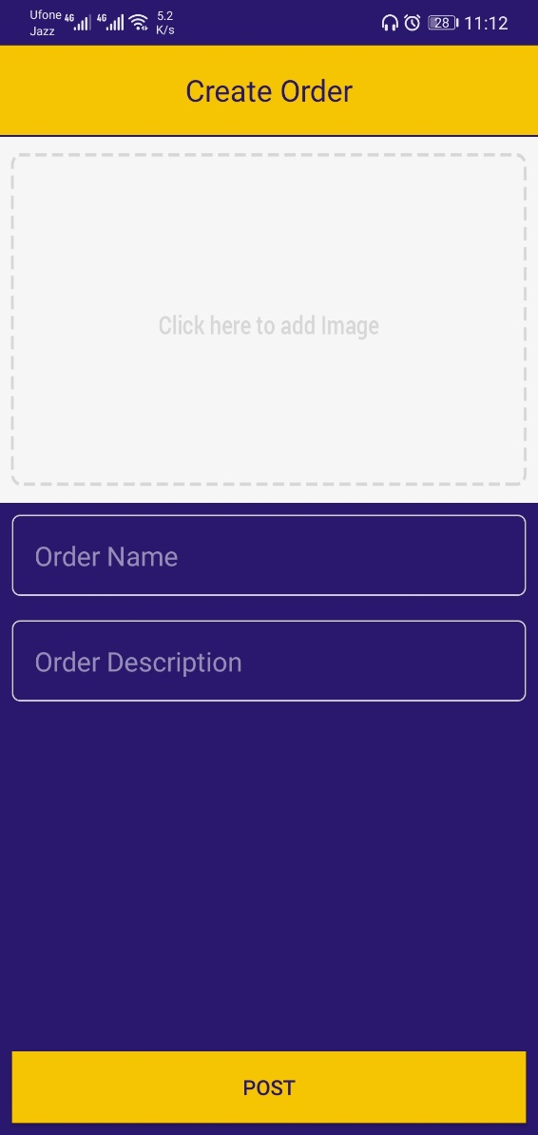
Create Orders

Slide 29
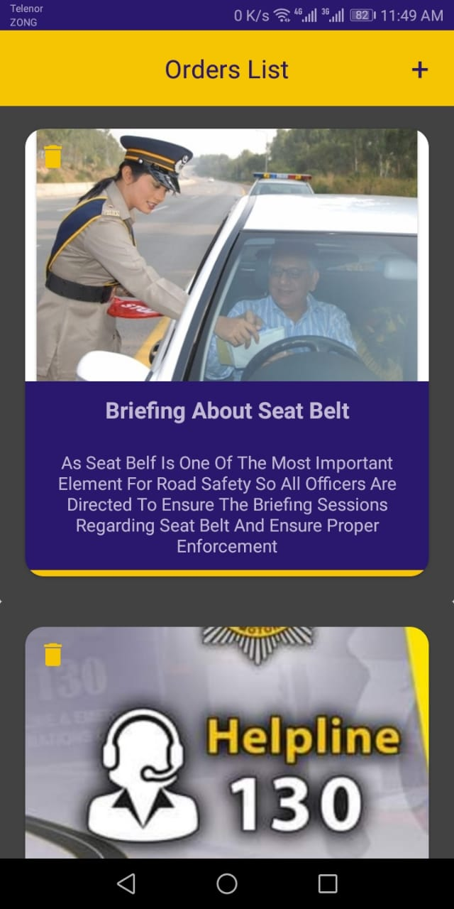
Orders List

Slide 30
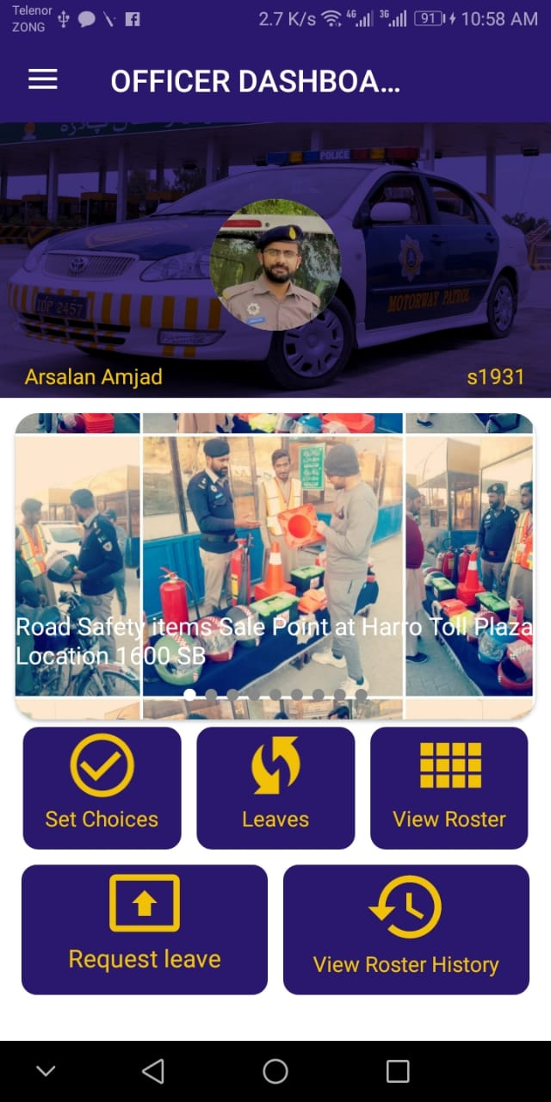
Officer Dashboard

Slide 31
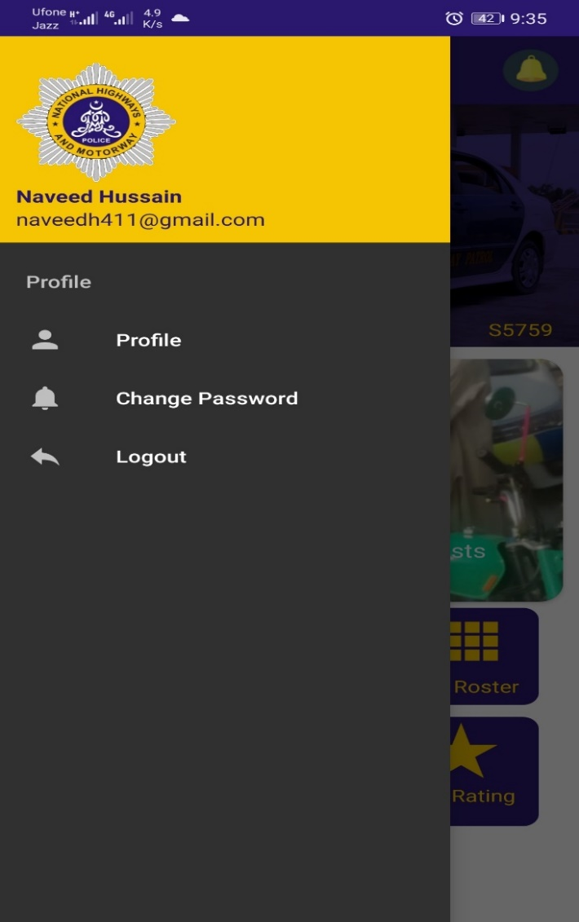
Drawer panel

Slide 32
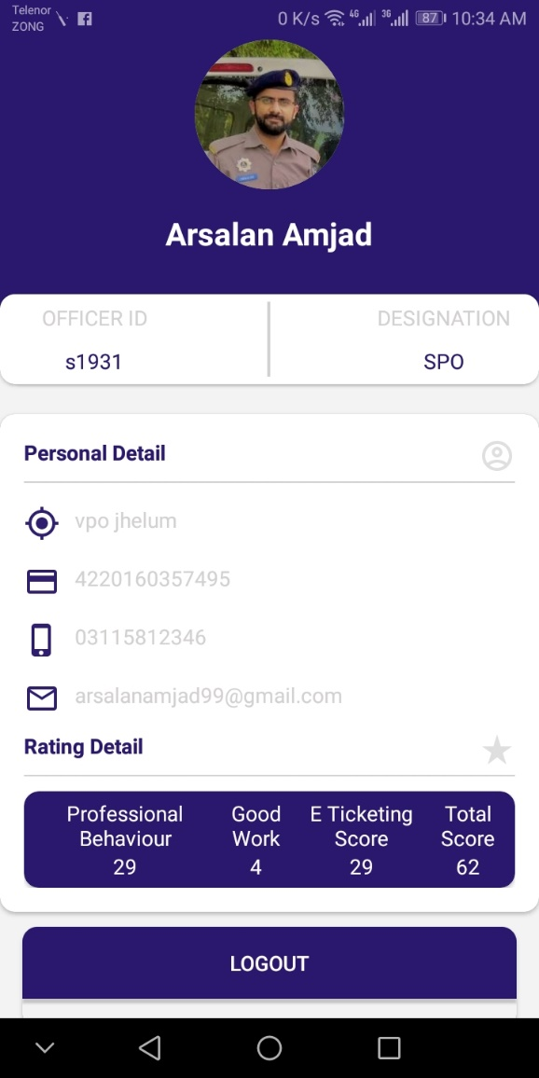
Profile

Slide 33
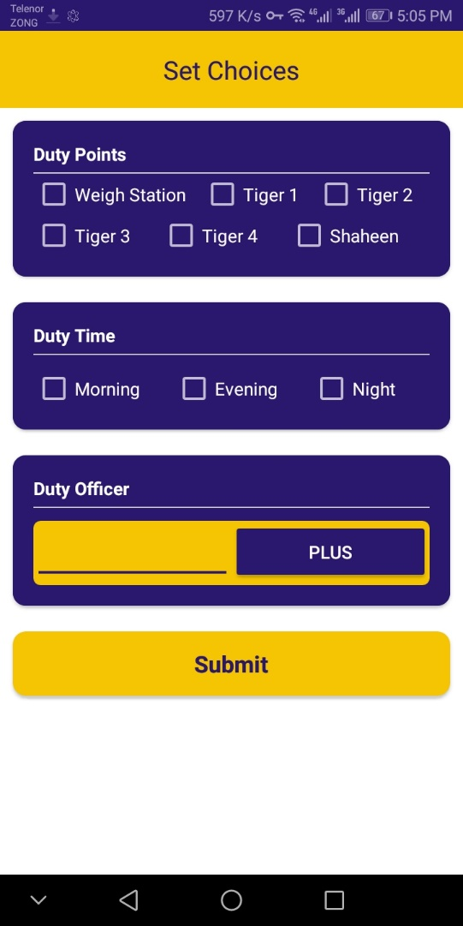
Set choices (For Senior officers)

Slide 34
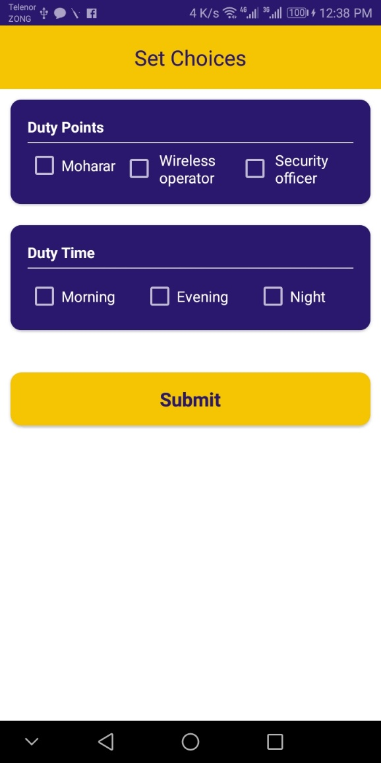
Set choices (For Junior Officers)

Slide 35
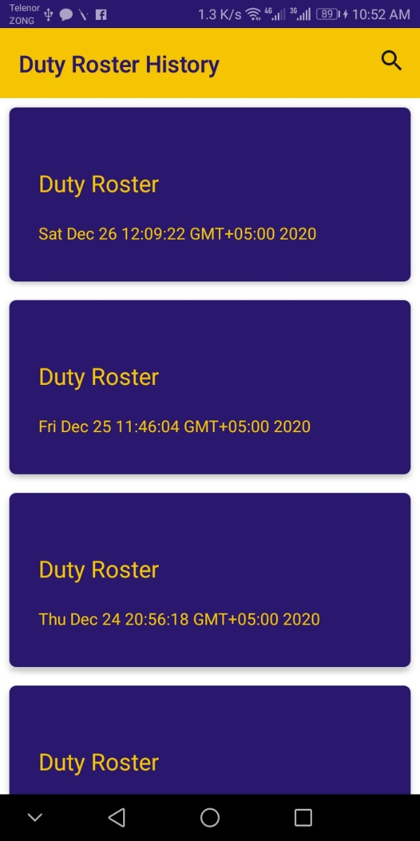
View Roster History

Slide 36
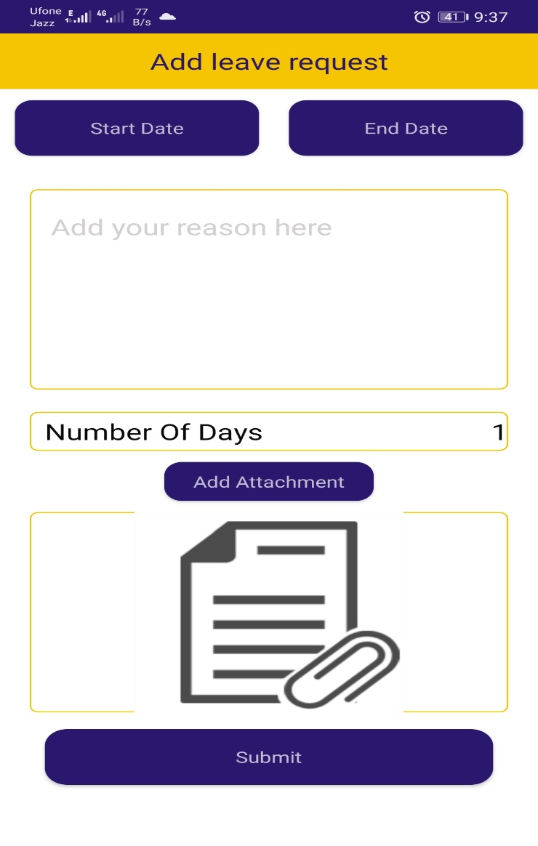
Add leave request

Slide 37
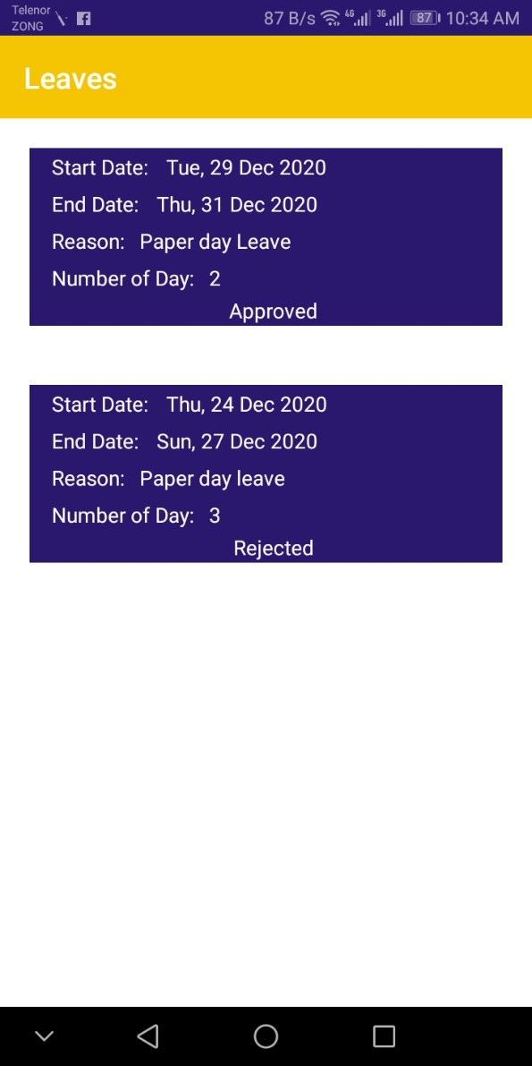
Leaves

Slide 38
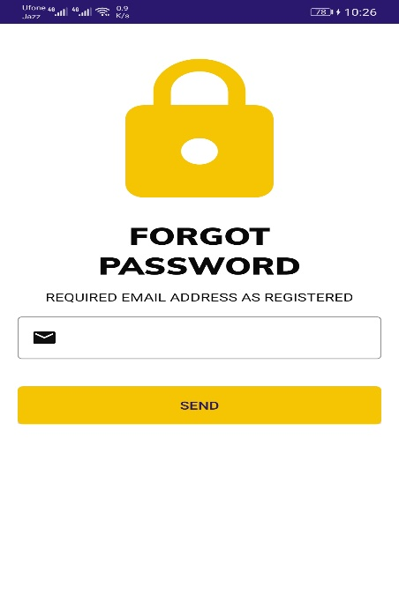
Forgot password

Slide 39
Conclusion
We learnt the usage of android studio & firebase or connect ion with different activities to each other. In our application we added many features
Moreover it will be implemented or used by NHMP.
In future, we can further improve our application through several ways like:
We will cover all beats under jurisdiction of NHMP.
The database of E-ticketing will be connected to enter the score of officers.
More interactive way of communication like chat, and detailed news feed.

Slide 40
References
http://www.islamabadtrafficpolice.gov.pk/violation-and-fine.php
https://www.youtube.com/playlist?list=PL1q3ROAofjeOUwh7lPBnGbg__DUodwLN7
https://www.encyclopedia.com/law/encyclopedias-almanacs-transcripts-and-maps/traffic-violations
https://7esl.com/vehicles-vocabulary/
https://www.youtube.com/watch?v=2MYgZQjX7N0
https://developer.android.com/studio/write/firebase
https://play.google.com/store/apps/details?id=com.papershiftlocationapp.android.plan&hl=en_US
https://play.google.com/store/apps/details?id=com.lorenzen.u8soccerroster&hl=en_GB
https://play.google.com/store/apps/details?id=org.planmyshift.planmyshift&hl=en_GB

Slide 41


Slide 42


